Slide 1
Next-Gen PHOENIX ​Personalized Hybrid Online-Offline Educational Network & Information eXchange
Submitted by:
Fathima Ashfa. B
Faseeha Zulaika. N
Hafna. S
Project Guide Name:
Mrs. Benedic Dhona, B.Tech., M.E., Ph.D.

Slide 2
ABSTRACT
With the growth of hybrid learning environments, students require effective guidance to choose suitable courses, educational institutions, and career opportunities.
Existing recommendation systems mainly focus on online content and fail to integrate offline education, departmental relevance, and employment needs.
This project proposes Next-Gen PHOENIX, a crowdsourced, hybrid online–offline educational recommendation system using Machine Learning, Deep Learning, and Explainable AI.
The system recommends courses based on the student’s department and interests, displays relevant job vacancies posted by companies, and suggests suitable online learning tools and nearby offline institutions.
Crowdsourced reviews, ratings, and surveys are used to improve recommendation accuracy, while fake reviews are filtered to ensure reliability.
Explainable AI provides transparent reasoning for recommendations, helping students make informed decisions.
Overall, the proposed system delivers a personalized learning and career pathway, enhancing trust, relevance, and decision-making in modern educational ecosystems.

Slide 3
OBJECTIVE
To develop a crowdsourced, hybrid online–offline educational recommendation system that provides personalized course, institution, and career guidance for students.
To recommend department-based courses, mapped job vacancies, and suitable educational institutions using Machine Learning, Deep Learning, and context-aware analysis.
To ensure transparent, reliable, and trustworthy recommendations through Explainable AI and genuine crowdsourced learner feedback.

Slide 4
INTRODUCTION
Rapid growth of hybrid learning has increased the need for effective guidance in choosing courses, institutions, and career paths.
Existing recommendation systems mainly focus on online learning, ignoring offline education and real-world constraints.
Students face difficulty in identifying department-relevant courses, suitable institutions, and job opportunities.
Crowdsourced reviews, ratings, and surveys provide valuable insights but are often unstructured and unreliable.
Next-Gen PHOENIX addresses these issues by offering a personalized, hybrid online–offline recommendation system using AI techniques.

Slide 5
EXISTING SYSTEM
Existing systems focus mainly on online educational apps and digital platforms.
Recommendations are based on simple data sources such as star ratings, download counts, and basic usage statistics.
Uses basic filtering techniques like keyword matching, popularity-based ranking, or category-wise recommendation.
Advanced models such as Collaborative Filtering (CF) and Deep Learning (GRU, LSTM) are used only for app usage prediction.
The system does not consider offline institutions, career goals, department relevance, or job vacancies.
Lacks context awareness, explainability, and crowdsourced qualitative insights from real learners.

Slide 6
DRAWBACKS OF EXISTING SYSTEM
Recommendations rely on simple metrics such as star ratings and download counts, which may not reflect actual learning quality.
Uses basic filtering methods (keyword or popularity-based), resulting in generic and less personalized suggestions.
Focuses only on online educational apps, ignoring offline courses and institutions.
Lacks context awareness such as location, budget, and infrastructure availability.
Cannot handle fake or biased reviews, reducing recommendation reliability

Slide 7
LITERATURE SURVEY

Slide 8
S.No | TITLE OF THE PAPER | AUTHOR | JOURNAL NAME & YEAR | METHOD USED | ADVANTAGES | DISADVANTAGES
1 | AI-Driven Hybrid Learning Ecosystems for Personalized Education | Wang et al. | IEEE Access (2024) | AI-based learner profiling + hybrid content delivery | • Personalized learning paths • Higher engagement | • High setup cost • Privacy concerns
2 | Intelligent Blended Learning Platforms Using Learning Analytics | Kumar & Lee | Elsevier (2024) | Learning analytics + predictive models | Early slow-learner detection • Data-driven insights | • Requires large datasets • Complex implementation
3 | Smart Education Networks Integrating Online and Offline Learning | Chen et al. | Springer SNCS (2024) | Cloud platform + offline synchronization | • Continuous learning access • Rural support | Sync latency • Maintenance overhead

Slide 9
S.No | TITLE OF THE PAPER | AUTHOR | JOURNAL NAME & YEAR | METHOD USED | ADVANTAGES | DISADVANTAGES
4 | Adaptive Learning Systems for Hybrid Education Using AI | Smith et al. | IEEE TLT (2025) | ML-based adaptive content delivery | • Dynamic learning adjustment • Improved outcomes | • Model bias risk • Retraining required
5 | Personalized Education Through AI-Enabled Hybrid Platforms | Rahman & Patel | ACM (2025) | Recommendation systems + user behavior analysis | Customized materials Better retention | Cold-start problem High computation
6 | Offline-First Digital Learning Systems for Inclusive Education | Lopez et al. | IJET (2024) | Offline caching + periodic cloud sync | Internet-independent learning Cost-effective | Limited real-time feedback Storage limits
7 | AI-Supported Knowledge Exchange Platforms in Education | Zhang et al. | IEEE ICCE (2024) | Knowledge graphs + intelligent retrieval | Efficient into exchange Collaboration support | Complex design Update challenges

Slide 10
S.No | TITLE OF THE PAPER | AUTHOR | JOURNAL NAME & YEAR | METHOD USED | ADVANTAGES | DISADVANTAGES
8 | Hybrid Learning Management Systems with Personalized Feedback | Ahmed et al. | Springer AI & Edu (2025) | NLP-based feedback + sentiment analysis | Real-time feedback • Improved motivation | NLP accuracy issues • Language dependency
9 | Secure Information Exchange in Smart Education Networks | Singh et al. | IEEE IoT Journal (2025) | Blockchain-based data sharing | • High security • Data integrity | Scalability issues • Increased latency
10 | Next-Generation Hybrid Education Platforms Using AI and IoT | Park et al. | Elsevier FGCS (2025) | AI analytics + IoT classroom integration | • Smart monitoring • Enhanced hybrid learning | High deployment cost • Device dependency

Slide 11
PROPOSED SYSTEM
A crowdsourced hybrid online–offline educational recommendation system using Machine Learning techniques (Collaborative Filtering, KNN, and content-based filtering) for course and institution matching, and Deep Learning models (GRU, RNN, and Autoencoders) for capturing complex learner patterns and generating real-time recommendations.
Recommends department-based courses and displays relevant job vacancies posted by companies.
Suggests suitable online educational apps and nearby offline institutions based on user preferences.
Utilizes crowdsourced reviews, ratings, and surveys, with fake review detection for reliable recommendations.
Incorporates context-aware analysis considering location, budget, and laboratory facilities.
Uses Explainable AI (XAI) to provide transparent and understandable recommendations.
Generates a personalized learning and career pathway for each student.

Slide 12
SYSTEM ARCHITECTURE
Users / Stakeholders
Crowdsourced Educational Data Collection
Hybrid Online–Offline Integration Module
Data Preprocessing & Feature Engineering
Explainable AI recommendation module
Educational Network & Information Exchange
ML & Deep Learning Personalization Engine
Feedback to Data Collection

Slide 13
MODULES
Users / Stakeholders
Crowdsourced Educational Data Collection Unit
Hybrid Online–Offline Learning Module
Data Preprocessing & Feature Engineering Techniques
ML & Deep Learning Personalization Engine
Educational Network & Information Exchange System
Explainable AI recommendation module
Feedback Loop to Data Collection

Slide 14
Users / Stakeholders
It represents all entities interacting with the PHOENIX platform, including students, educational institutions, companies, and system administrators.
It supports role-based access control to ensure secure and personalized interactions.
Each user role generates distinct types of educational data, such as course preferences and reviews from students, institutional details from educational organizations, and job vacancy information from companies.
This module acts as the primary interface between users and the system, enabling data collection and personalized recommendation services.

Slide 15
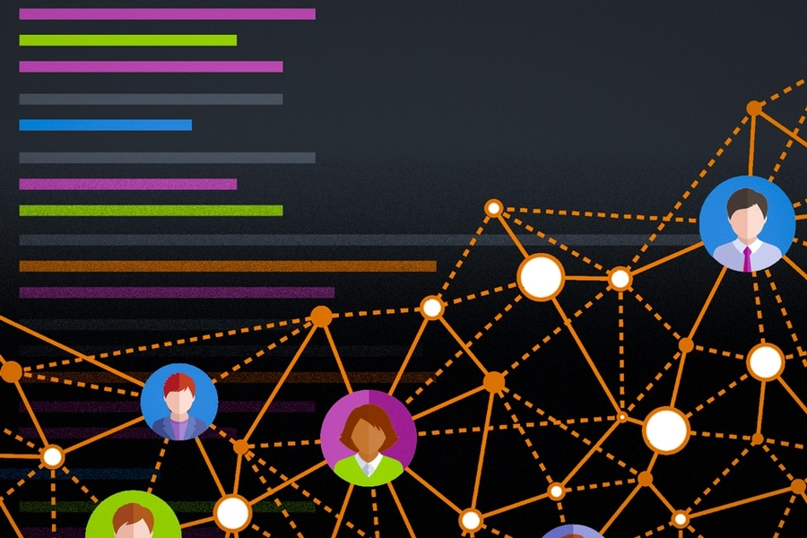
Crowdsourced Educational Data Collection Unit
This unit is responsible for collecting large-scale educational data generated by users during platform interaction.
The data includes learning behavior, content usage patterns, ratings, reviews, and feedback.
Since the data is crowdsourced from diverse users, it reflects real-world learning preferences and engagement levels.
This continuously growing dataset serves as the foundation for personalization and intelligent recommendation within the PHOENIX system.

Slide 16
Hybrid Online–Offline Integration Module
This module is responsible for establishing structured connections between various educational entities within the system. It links courses with both online learning platforms and offline institutions, creating an integrated educational framework
In addition, the module maps courses to the specific skills they develop and further connects those skills to relevant job roles in the industry.
The module also highlights institutions offering industry-relevant programs and aligns them with current job market requirements collected in the PHOENIX system.
It is important to note that this module does not directly generate recommendations. Instead, it builds and maintains the structured relationships between courses, skills, institutions, and job roles.
These relationships serve as the foundational knowledge base that is later utilized by the personalization engine to generate accurate, context-aware, and career-oriented recommendations.

Slide 17
Data Preprocessing & Feature Engineering
Techniques
Data Preprocessing prepares raw crowdsourced data for intelligent analysis by performing data cleaning, transformation, and feature extraction.
Noisy, incomplete, and inconsistent data is removed or corrected, while numerical values are normalized and categorical values are encoded.
Feature engineering techniques are applied to extract meaningful attributes such as learning frequency, content preference, and engagement level.
The resulting structured feature set enables accurate and efficient machine learning and deep learning model training.

Slide 18
ML & Deep Learning Personalization Engine
This Engine forms the core intelligence of the PHOENIX system.
It employs machine learning algorithms to identify user similarity and learning patterns, while deep learning models capture complex and non-linear relationships between users and educational content.
The engine builds dynamic user profiles and continuously adapts them based on new interaction data.
By learning from both historical and real-time data, this module enables highly personalized learning experiences and recommendation accuracy.
Graph Autoencoders are deep learning models designed to learn low-dimensional representations of graph-structured data.
They encode relationships between nodes (such as users and educational content) into latent embeddings while preserving network structure.

Slide 19
CONT..
A Stacked Autoencoder consists of multiple autoencoder layers stacked together to perform hierarchical feature learning and Each layer learns increasingly abstract representations of the input data.
SAE is used to reduce data sparsity and noise in crowdsourced educational data while extracting high-level learning behavior patterns.
Long Short-Term Memory(LSTM) is a specialized recurrent neural network capable of learning long-term dependencies in sequential data,it overcomes the vanishing gradient problem present in traditional RNNs.
Deep learning techniques enable intelligent educational recommendation by learning complex, non-linear patterns from large-scale crowdsourced data.
These models automatically extract features, adapt to user behavior, and improve over time through continuous learning.

Slide 20
Educational Network & Information Exchange System
The Educational Network & Information Exchange facilitates structured information exchange among students, teachers, and institutions within the PHOENIX ecosystem.
It supports content sharing, collaborative learning, and communication through a secure network layer.
Educational resources, feedback, and performance insights are exchanged seamlessly, promoting knowledge dissemination and community-based learning.
This system transforms PHOENIX from a standalone recommendation system into a connected educational network.

Slide 21
Explainable AI recommendation module
The Explainable AI Recommendation Module provides transparent explanations for the recommendations generated by the ML and Deep Learning personalization engine.
It explains why specific courses, online platforms, and offline institutions are suggested to a student.
The system highlights important factors such as student department, interests, peer reviews, institutional quality, location, and job market demand.
By providing clear reasoning behind recommendations, the module improves user trust, interpretability, and informed decision-making within the PHOENIX framework.

Slide 22
Feedback Loop to Data Collection
This module enables the system to evolve by collecting user feedback, interaction logs, and performance metrics after recommendations are delivered.
The feedback data is reintegrated into the crowdsourced dataset, allowing periodic retraining and optimization of machine learning and deep learning models.
This continuous learning mechanism ensures that PHOENIX remains adaptive to changing user needs and learning trends, maintaining long-term system accuracy and effectiveness.

Slide 23

CONCLUSION
The Next-Gen PHOENIX framework presents an intelligent and scalable educational platform that integrates crowdsourced educational data with advanced deep learning techniques to deliver personalized learning experiences.
By combining hybrid online–offline learning support with machine and deep learning-driven personalization, the system ensures uninterrupted access to educational resources while adapting to individual learner needs.
The use of deep learning models such as Graph Autoencoders, Stacked Autoencoders, and Long Short-Term Memory networks enables effective modeling of complex educational relationships, reduction of data sparsity, and analysis of temporal learning behavior.
Furthermore, the inclusion of an educational network and information exchange layer enhances collaboration among students, teachers, and institutions.
Overall, PHOENIX improves recommendation accuracy, learner engagement, and accessibility, making it a robust next-generation educational ecosystem.

Slide 24
REFERRENCE
F. Roy and M. Hasan, ‘‘An item–item collaborative filtering recommender system based on item reviews: An approach with deep learning,’’ Vietnam J. Comput. Sci., vol. 10, no. 4, pp. 517–536, Aug. 2023.
A. Abirami and S. D. S. Azariya, ‘‘Fractional-order backpropagation through time for training recurrent neural networks,’’ Nanotechnol. Perceptions,vol. 20, no. S2, pp. 756–767, 2024.
E. Genov, C. D. Cauwer, G. V. Kriekinge, T. Coosemans, and M. Messagie, ‘‘Forecasting flexibility of charging of electric vehicles:Tree and cluster-based methods,’’ Appl. Energy, vol. 353, Jan. 2024,Art. no. 121969.
Image V. G. Aishvarya Shree & Image M. Thangaraj,
Intelligent Autoencoder with LSTM based Intrusion Detection and Recommender System, International Journal of Computer Network and Information Security (IJCNIS), Oct. 2025.
Vinod B. Ingale et al., A Hybrid Neural Architecture For Next-Item Recommendation Using Temporal Point Processes And Self-Attention On Event-Based Data,JSRET, Sep-Oct 2025.
Rui Xue, Shichao Zhu et al., E2E-GRec: An End-to-End Joint Training Framework for Graph Neural Networks and Recommender Systems,arXiv, Nov. 2025.

